Slide 1
A Detailed Look in to Energy Consumption and Pollution Related Deaths
Presentation by PollutionSolvers - Zhongyang Hu, Hsueh-Yi Lu, Ali Can Mutlu,

Slide 2
Data Set Information -
Data Sets taken from Kaggle
Main features: Nitrogen, GDP, Death per 100,000 people, Indoor Air Pollution, Outdoor Ozone Pollution, Outdoor Particulate Matter

Slide 3
Dataset Summary
data_health: 2.12_Health_systems.csv
Source: Kaggle
Variables:
Country_Region: Qualitative,Categorical Completeness_of_birth_reg_2009-18: Numerical,Continuous
World_Bank_Name : Qualitative,Categorical per_capita_exp_PPP_2016: Numerical,Continuous
Health_exp_pct_GDP_2016 : Numerical,Continuous External_health_exp_pct_2016: Numerical,Continuous
Health_exp_public_pct_2016 : Numerical,Continuous Physicians_per_1000_2009-18: Numerical,Continuous
Health_exp_out_of_pocket_pct_2016 : Numerical,Continuous Nurse_midwife_per_1000_2009-18: Numerical,Continuous
Health_exp_per_capita_USD_2016 : Numerical,Continuous Specialist_surgical_per_1000_2008-18: Numerical,Continuous

Slide 4
Dataset Summary
data_clean: cleanFuelAndTech.csv
Source: Kaggle
Variables:
Location: Qualitative,Categorical
Indicator: Qualitative,Categorical
Period: Numerical, Categorical
First Tooltip: Numerical,Continuous

Slide 5
Dataset Summary
data_pollution: death-rates-from-air-pollution.csv
Source: Kaggle
Variables:
Entity: Qualitative,Categorical
Code: Qualitative,Categorical
Year: Numerical, Categorical
Air pollution (total) (deaths per 100,000): Numerical,Continuous
Indoor air pollution (deaths per 100,000):Numerical,Continuous
Outdoor particulate matter (deaths per 100,000):Numerical,Continuous
Outdoor ozone pollution (deaths per 100,000):Numerical,Continuous

Slide 6
Dataset Summary
data_GDP: Country_wise_GDP_from_1994_to_2017.csv
Source: Kaggle
Variables:
Country: Qualitative,Categorical Population: Numerical,Continuous
Year: Numerical, Categorical Pop. change (%): Numerical,Continuous
GDP (in USD): Numerical,Continuous GDP Real (in USD):Numerical,Continuous
GDP change (%):Numerical,Continuous
GDP per capita (in USD):Numerical,Continuous

Slide 7
Dataset Summary
data_energy: Percentage_of_Energy_Consumption_by_Country.csv
Source: Kaggle
Variables:
Country: Qualitative,Categorical Hydro Generation – TWh:Numerical,Continuous
Code: Qualitative,Categorical Nuclear Generation – TWh: Numerical,Continuous
Year: Numerical, Categorical Solar Generation – TWh: Numerical,Continuous
Coal Consumption - EJ :Numerical,Continuous Wind Generation –TWh: Numerical,Continuous
Gas Consumption - EJ Numerical,Continuous Oil Consumption – EJ: Numerical,Continuous
Geo Biomass Other - TWh :Numerical,Continuous

Slide 8
Data Pre-Processing
class preprocessing():
def indoor2016(self): df1=self.dfselection(self.setf2,self.data_health,'World_Bank_Name') df2=self.dfselection(self.setf2,self.data_clean,'Location') df3=self.dfselection(self.setf2,self.data_pollution,'Entity') df4=self.dfselection(self.setf2,self.data_GDP,'Country') df2=df2[df2['Period']==2016] df3=df3[df3['Year']==2016] df4=df4[df4['Year']==2016] df1=df1.rename(columns={"World_Bank_Name": "Location"}) df3=df3.rename(columns={'Entity':'Location'}) df4=df4.rename(columns={'Country':'Location'}) out=pd.merge(df1,df2,how='outer',on='Location') out=pd.merge(out,df3,how='outer',on="Location") out=pd.merge(out,df4,how='outer',on='Location') out=out.drop(columns='Province_State') return out

Slide 9
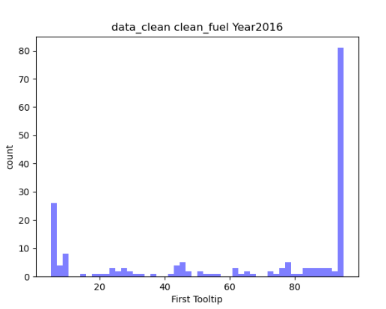
EDA
dc2016 = data_clean_p[data_clean_p['Period'] == 2016] num_bins = 50 # the histogram of the data n, bins, patches = plt.hist(dc2016['First Tooltip'], num_bins, facecolor='blue', alpha=0.5) plt.xlabel('First Tooltip') plt.ylabel('count') plt.title('data_clean clean_fuel Year2016') plt.show()

Slide 10
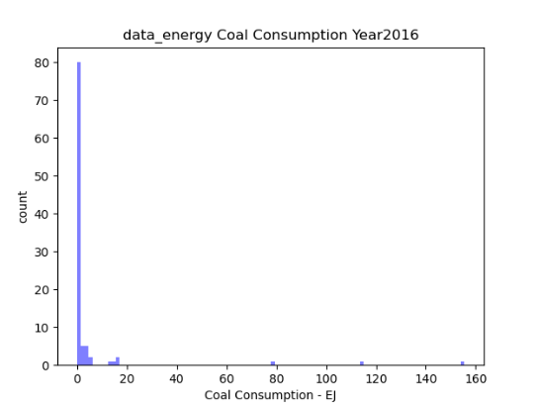
EDA
de2016 = data_energy_p[data_energy_p['Year'] == 2016] num_bins = 100 n, bins, patches = plt.hist(de2016['Coal Consumption - EJ'], num_bins, facecolor='blue', alpha=0.5) plt.xlabel('Coal Consumption - EJ') plt.ylabel('count') plt.title('data_energy Coal Consumption Year2016') plt.show()

Slide 11
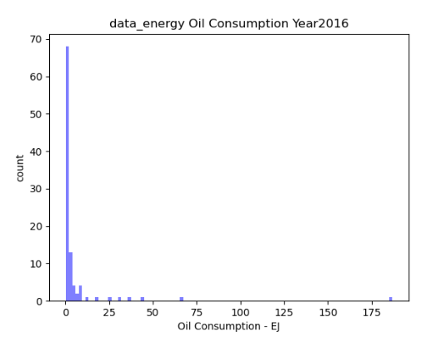
EDA
num_bins = 100 n, bins, patches = plt.hist(de2016['Oil Consumption - EJ'], num_bins, facecolor='blue', alpha=0.5) plt.xlabel('Oil Consumption - EJ') plt.ylabel('count') plt.title('data_energy Oil Consumption Year2016') plt.show()

Slide 12
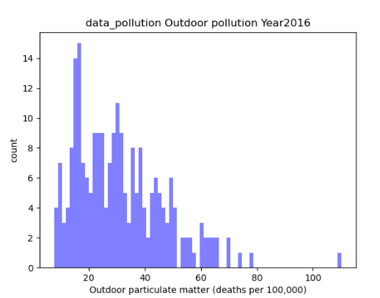
EDA
dp2016 = data_pollution_p[data_pollution_p['Year'] == 2016] num_bins = 75 n, bins, patches = plt.hist(dp2016['Outdoor particulate matter (deaths per 100,000)'], num_bins, facecolor='blue', alpha=0.5) plt.xlabel('Outdoor particulate matter (deaths per 100,000)') plt.ylabel('count') plt.title('data_pollution Outdoor pollution Year2016') plt.show()

Slide 13
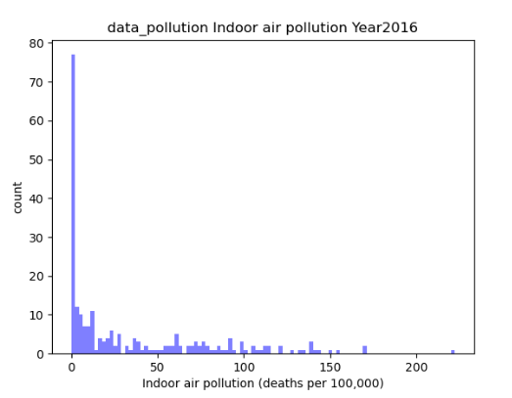
EDA
num_bins = 100 n, bins, patches = plt.hist(dp2016['Indoor air pollution (deaths per 100,000)'], num_bins, facecolor='blue', alpha=0.5) plt.xlabel('Indoor air pollution (deaths per 100,000)') plt.ylabel('count') plt.title('data_pollution Indoor air pollution Year2016') plt.show()

Slide 14
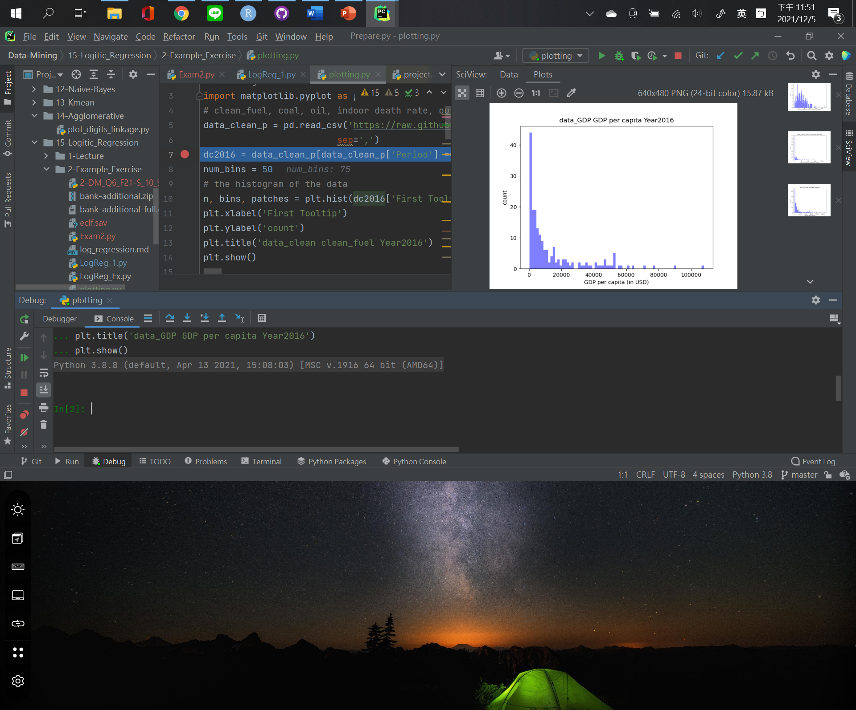
EDA

Slide 15
Introduction of the Model

Slide 16
Evaluation of the Correlation

Slide 17
Findings – Basic Model

Slide 18
Transform of Data

Slide 19
Generating Data Features

Slide 20
Accuracy Result

Slide 21
Residual Result

Slide 22
GUI GRAPHS DISPLAY

Slide 23
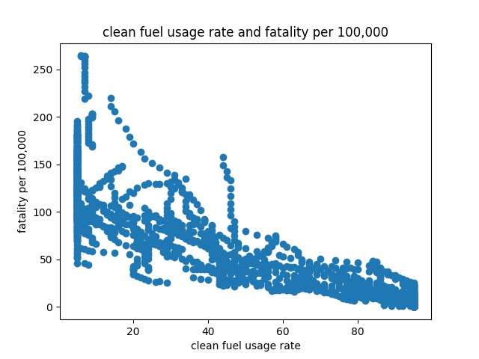


Slide 24
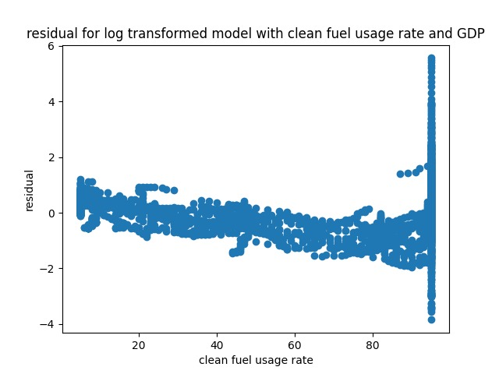

Slide 25
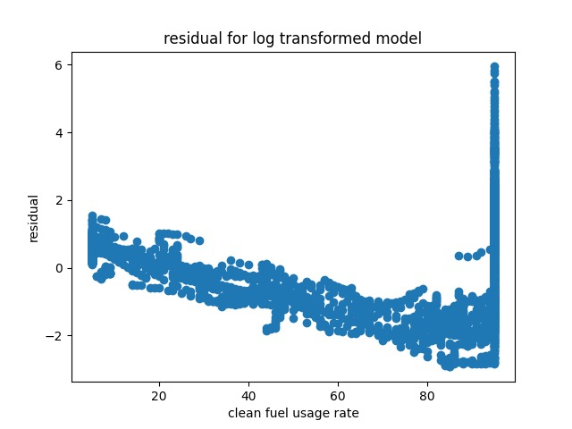

Slide 26
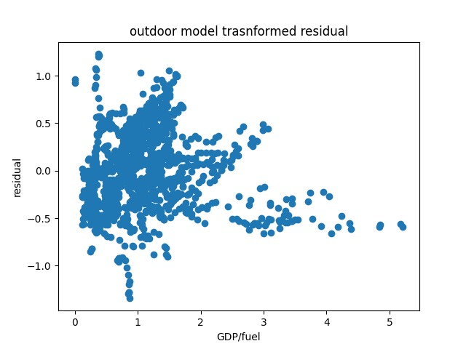

Slide 27
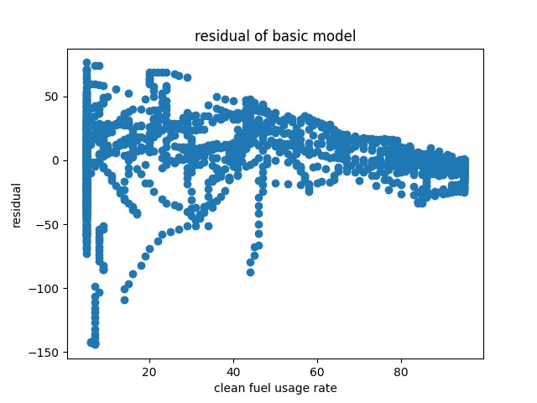

Slide 28
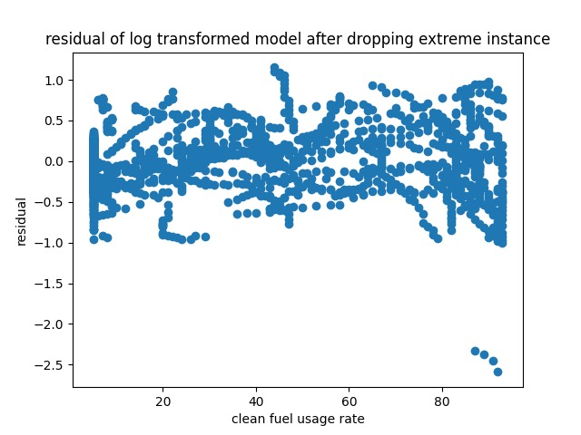

Slide 29
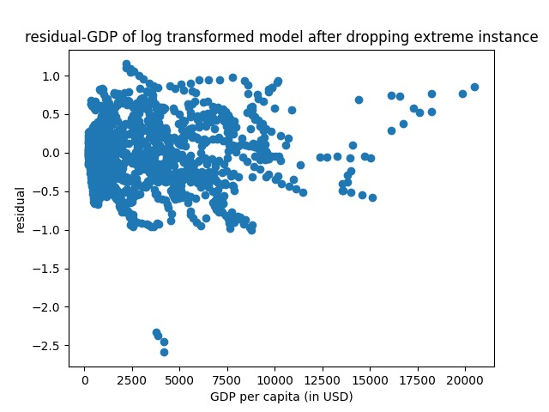

Slide 30
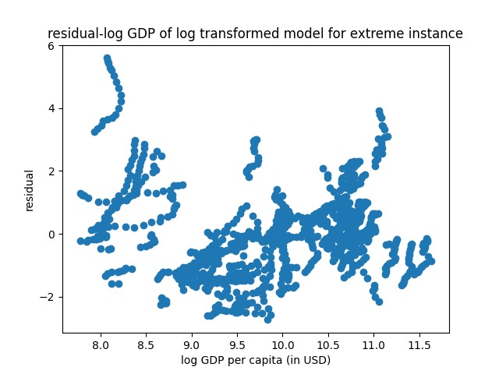

Slide 31
References

Slide 32
What Next?

